Slide 1
Interferometry Celebration
Spokane Astronomical Society
May 2, 2003

Slide 2
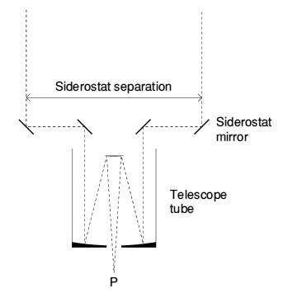
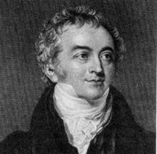
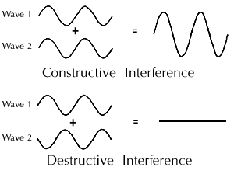
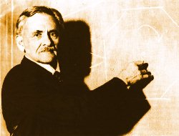
History
Notes:
Young – 1803 Bakerian Lectures, Michelson 1882, 1907, 1920 “Differential Refractometer”. Ryle Vonberg 1947 MRAO Cambridge. Hanbury-Twiss, Brown 1957. Antoine Labeyrie 1975.

Slide 3
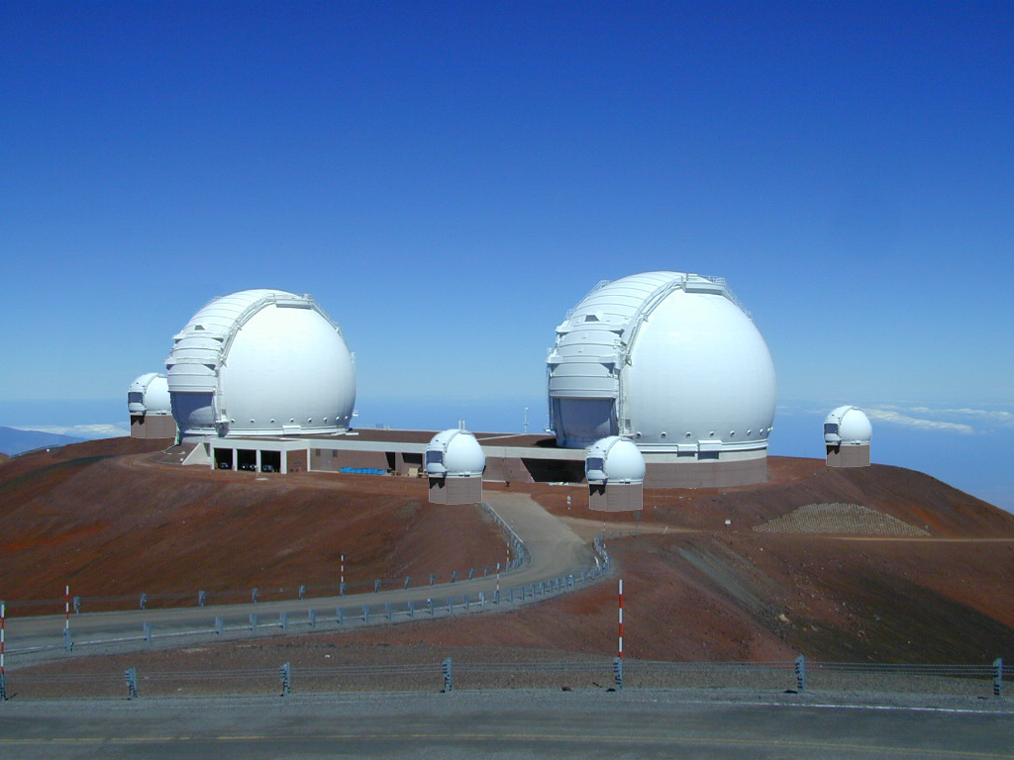
Keck
Notes:
CARA, 2 elements, (4 more planned), Main elements are 10 meter but the satellites will only be 1.8 meter mirrors. The baseline is 140 meters. June 2002

Slide 4
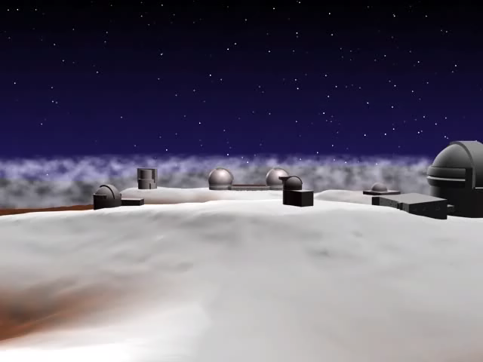

Slide 5
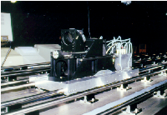
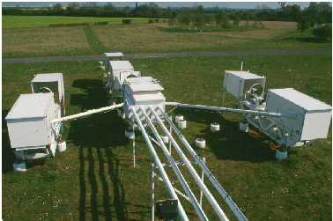
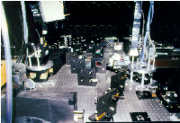
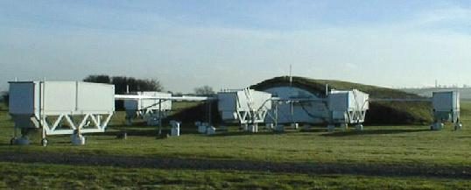
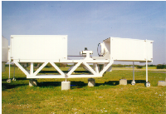
COAST
Notes:
COAST Cambridge Optical Aperture Synthesis Telescope, MRAO England FF 95 on Capella twins. 5 elements (40cm ea), 22 meter baseline

Slide 6
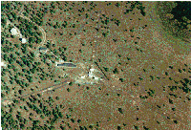
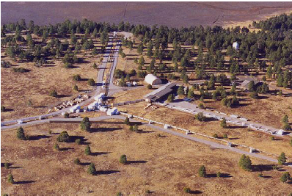
NPOI
Notes:
NPOI Navy Prototype Optical Interferometer, Lowell Observatory, Anderson Mesa, Arizona
6 elements (60cm ea), 145m baseline. First synthetic image in March 1996

Slide 7
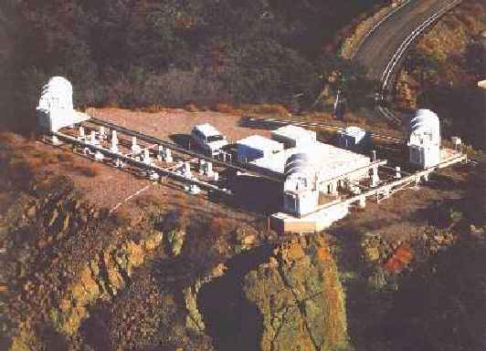
IOTA
Notes:
Cfa/U Mass, Mount Hopkins 3 elements (45cm ea), 38 m baseline. First Synthetic image in February 2002 after it got IONIC 3-way combiner.

Slide 8
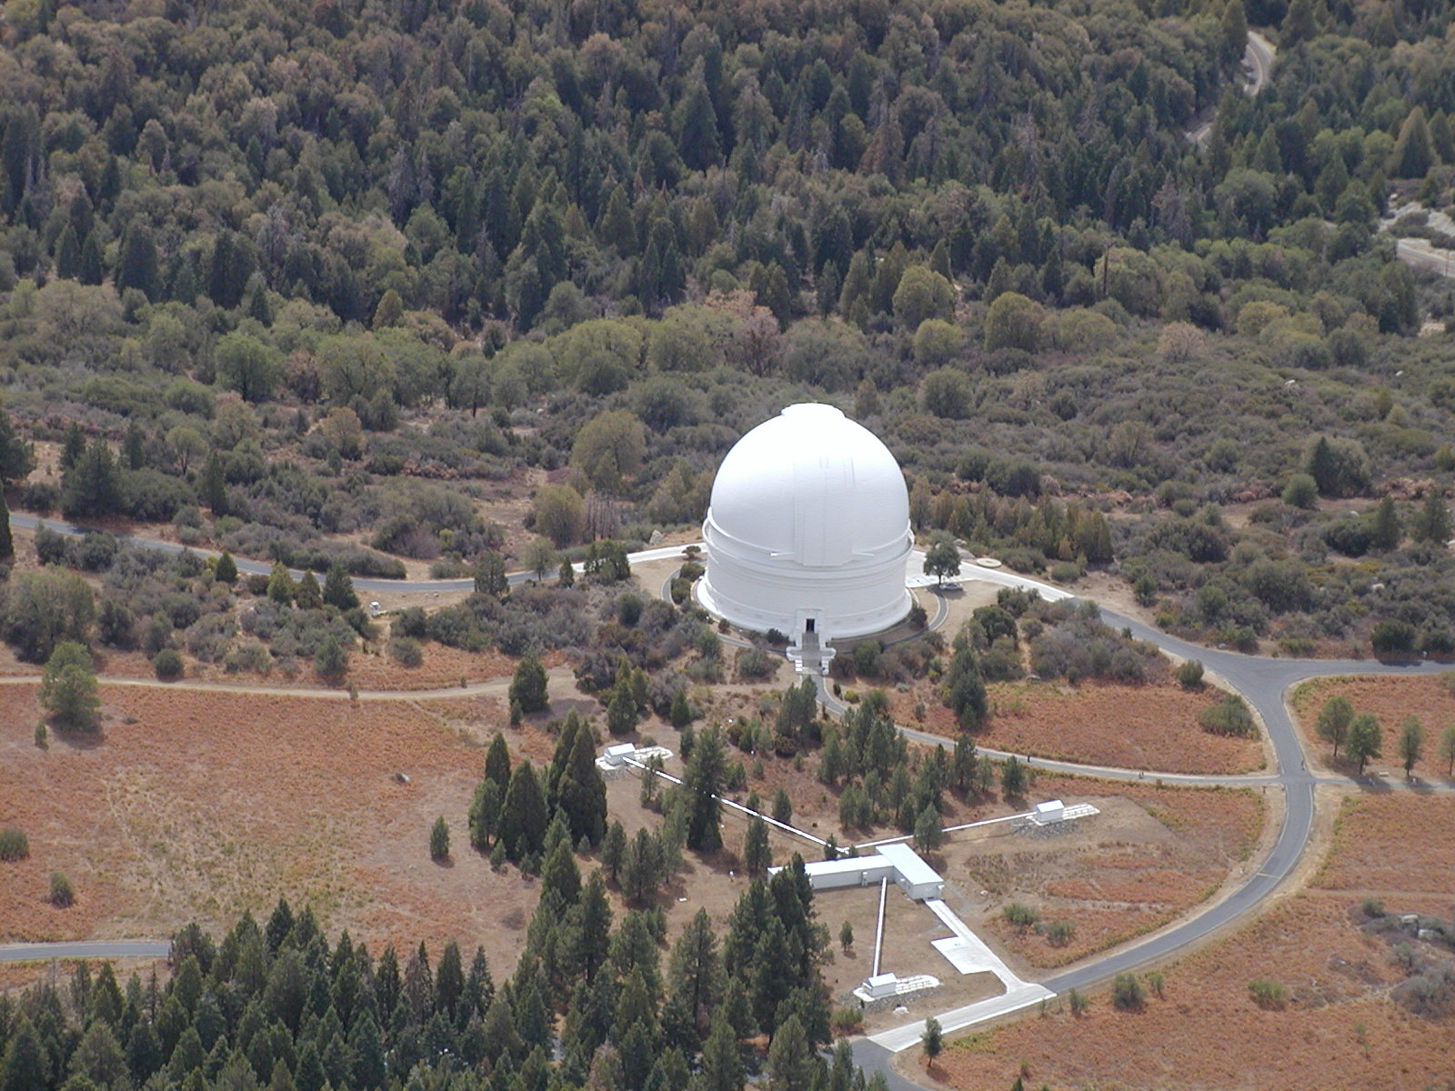
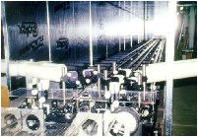
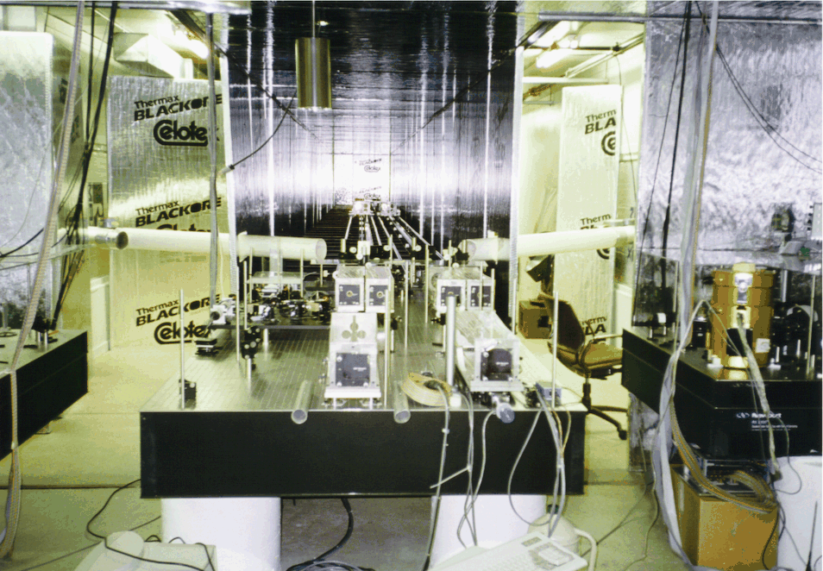
PTI
Notes:
PTI Palomar testbed interferometer, Mount Palomar, California
2 elements ( 40cm ea), 110 m baseline. NICMOS combiner.

Slide 9
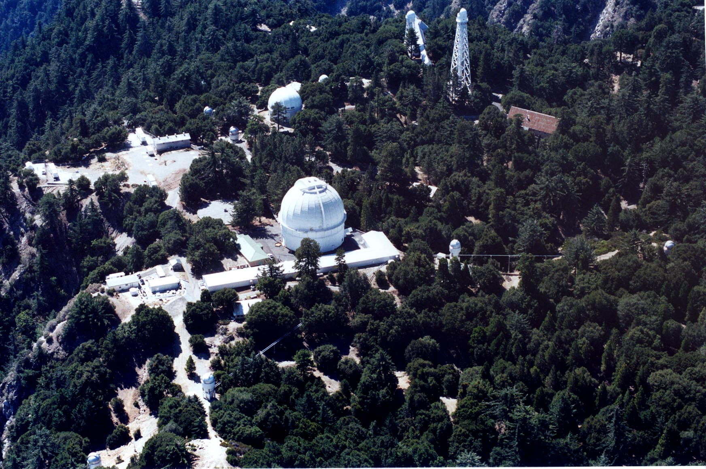
CHARA
Notes:
Georgia State Univ., Mount Wilson
6 elements (10 cm ea.), 350 m baseline. FF November 1999. FLUOR fiber-optic combiner since Augusst 2002.

Slide 10
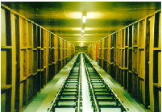
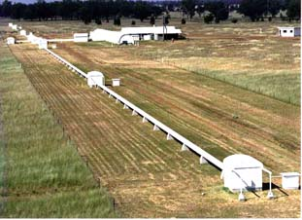
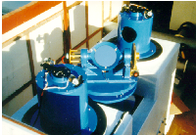
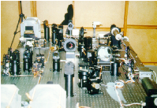
SUSI
Notes:
SUSI Sydney University Stellar Interferometer. Narrabri Australia
13 elements (14cm ea), 640 m baseline

Slide 11
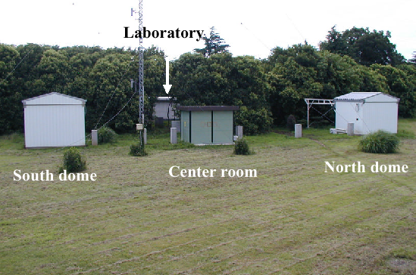
MIRA

Slide 12
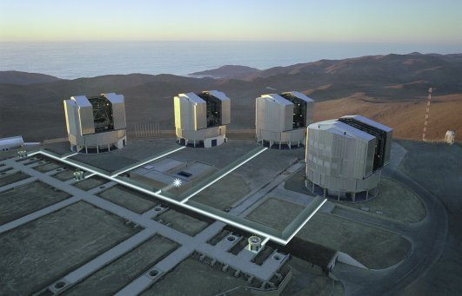
VLTI
Notes:
Cerra Paranal. FF October 29, 2001 with VINCI fiber-optic combiner. MIDI combiner installed in December 2002.

Slide 13
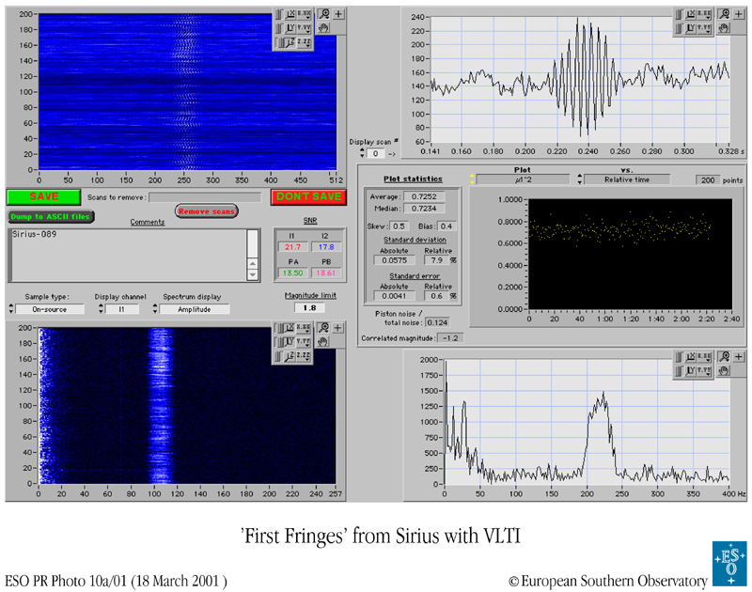

Slide 14
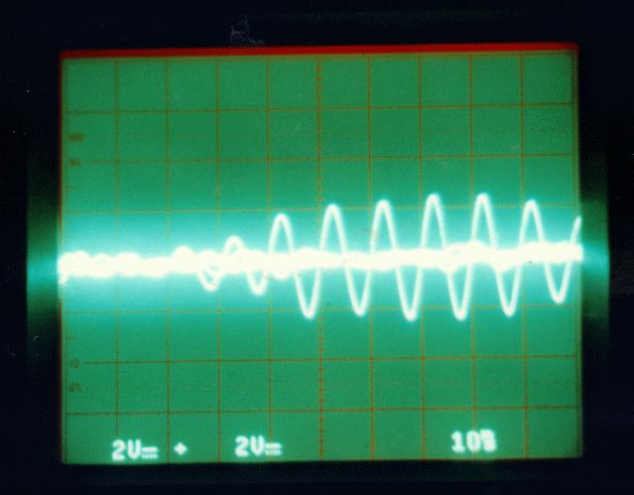
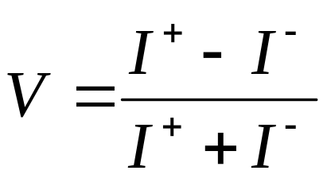
Fringe Visibility
Constructive & destructive interference of light
Fringe contrast or visibility:
Calibration issues
  Detector linearity
  Zero point measm’t
  Noise characterizat’n
Zero
OPD
Noise
I+
I-
Fringe
Envelope
Actual starlight fringes from IOTA - β And
Photo credit: R.R. Thompson
Notes:
2. A good basic "fringe" picture, showing starlight intensity on a time-lapse photo
of an oscilliscope as the zero path position was swept through at IOTA. I spent
*many* (300+) nights at IOTA staring at the 'scope, looking for fringes packets just
like this one...

Slide 15
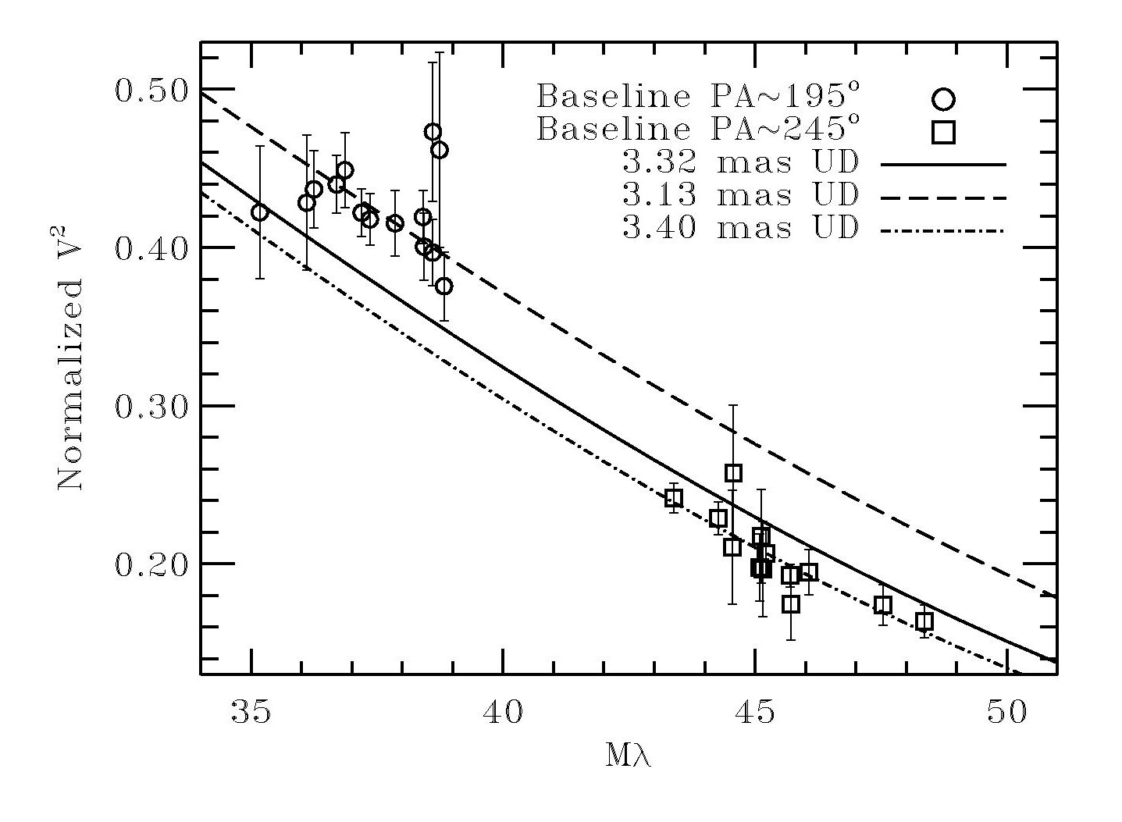
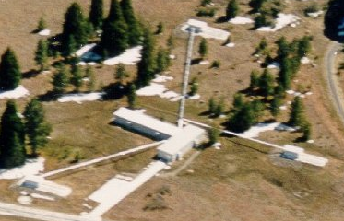
Initial Indications of Something Interesting with Altair
Use of the PTI N-S and N-W baselines gave different angular sizes
Not explainable in terms of limb darkening, spotting, binarity
N-S Baseline
50°
N-W Baseline

Slide 16

Notes:
Gerard’s JPL presentation on Altair

Slide 17
Modes and Uses
Astrometry
Planets
Angular Diameter – Rotation
Hot Jupiters
Nulling
Circumstellar dust
Planets
Imaging
Protoplanetary disks
Two-color differential Astrometry
Venus-sized planets
Notes:
Nulling: Reject light from central star
Two-color differential astrometry
Astrometry
Differential astrometry
Imaging

Slide 18
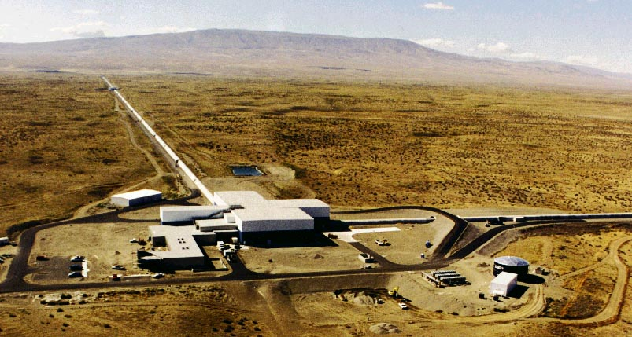
LIGO

Slide 19
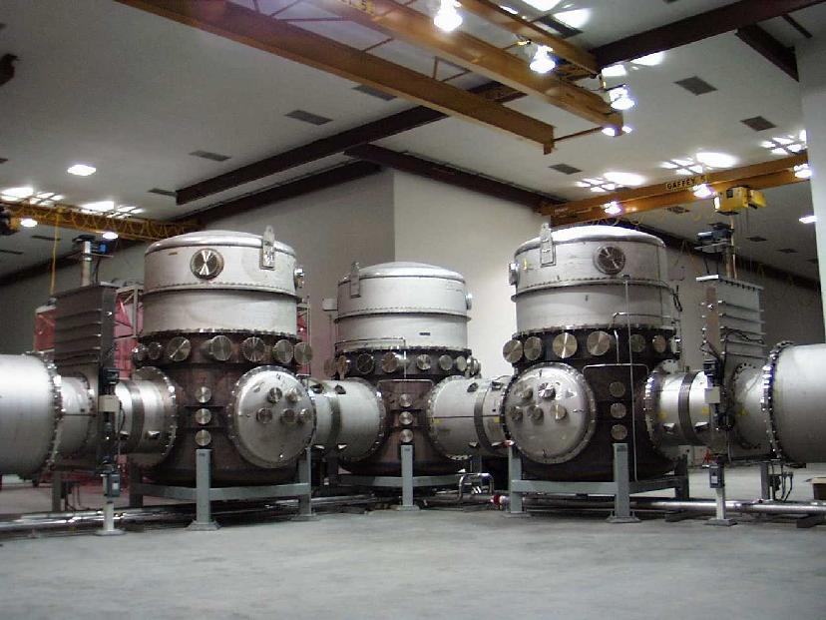

Slide 20
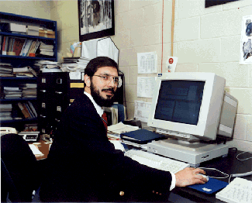

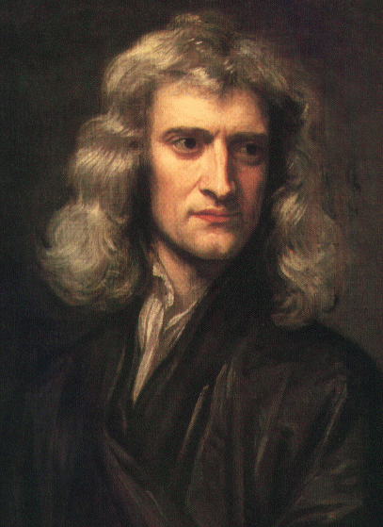
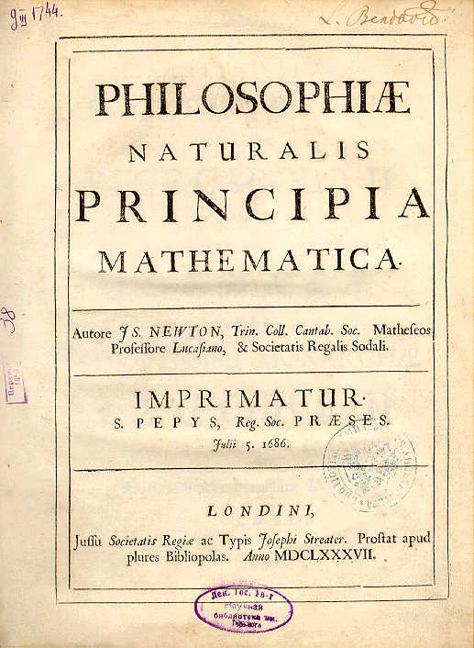


Slide 21
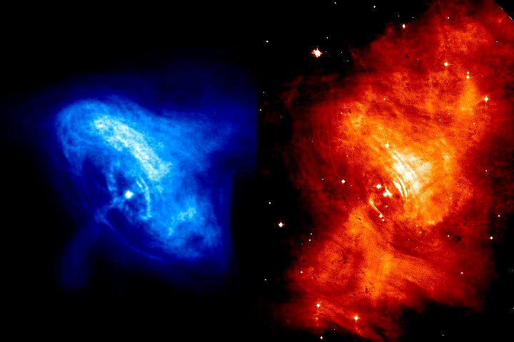
Notes:
Crab Nebula (M1) in Taurus. X-ray and Infrared. Pulsar 30 rps.

Slide 22
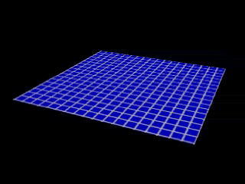

Slide 23
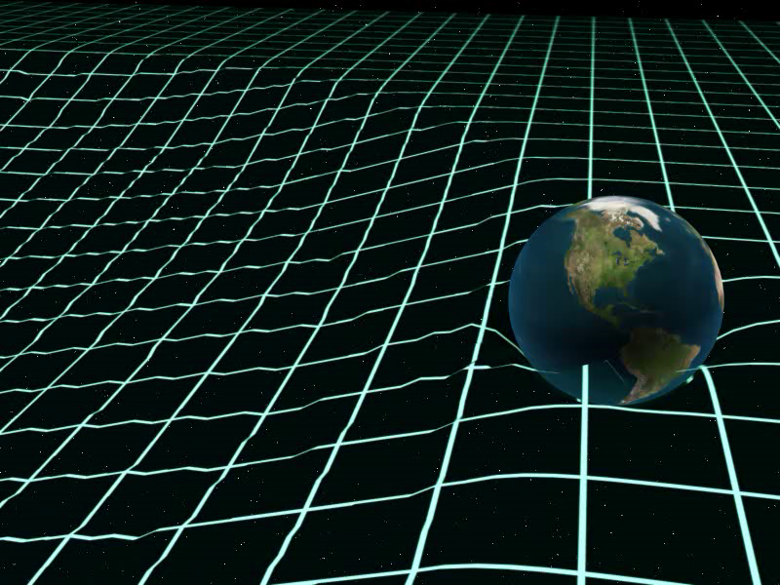

Slide 24
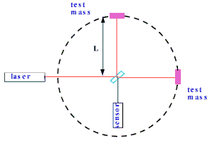

Slide 25
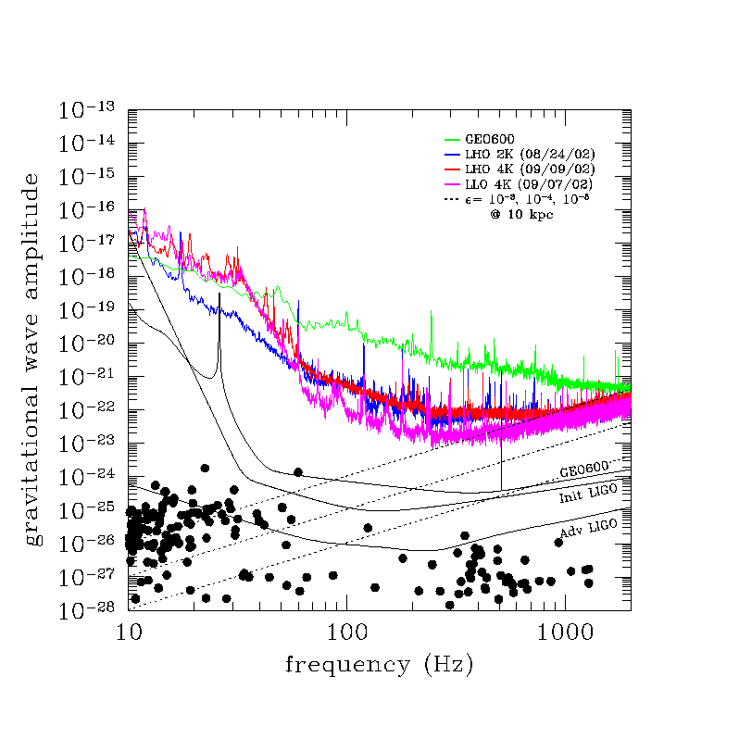
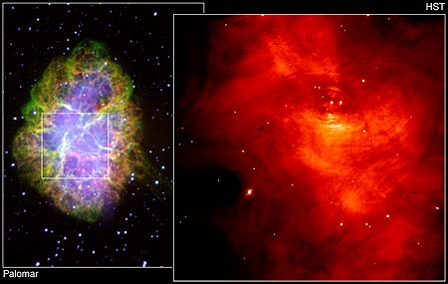
S1 sensitivities
-- GEO
-- L 2km
-- H 4km
-- L 4km
hc
Crab pulsar

Slide 26
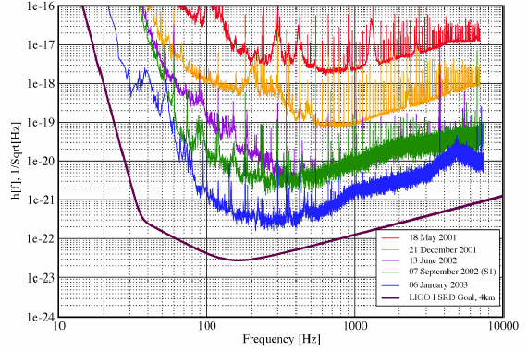

Slide 27
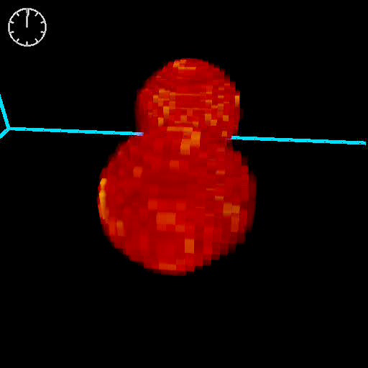

Slide 28
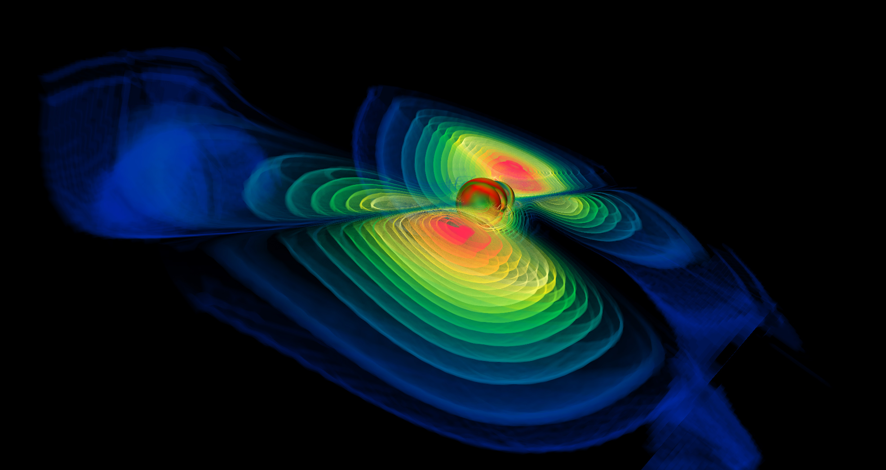

Slide 29
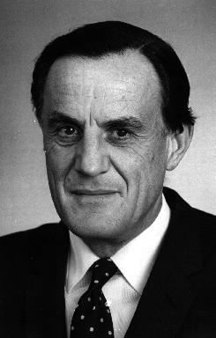
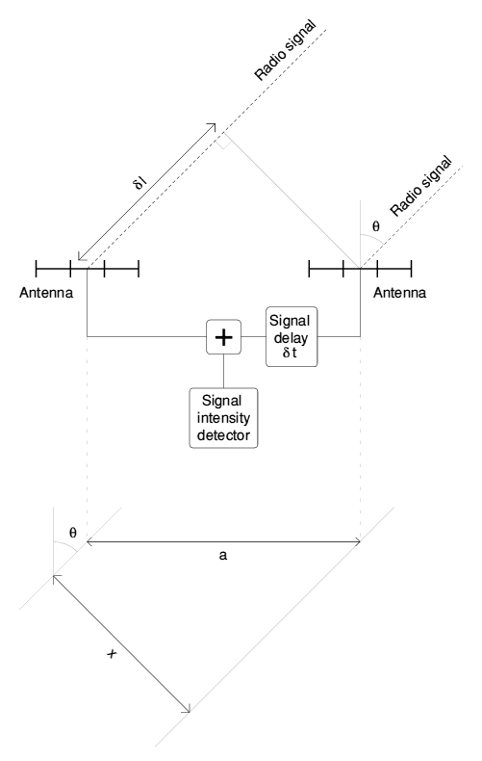
Radio

Slide 30
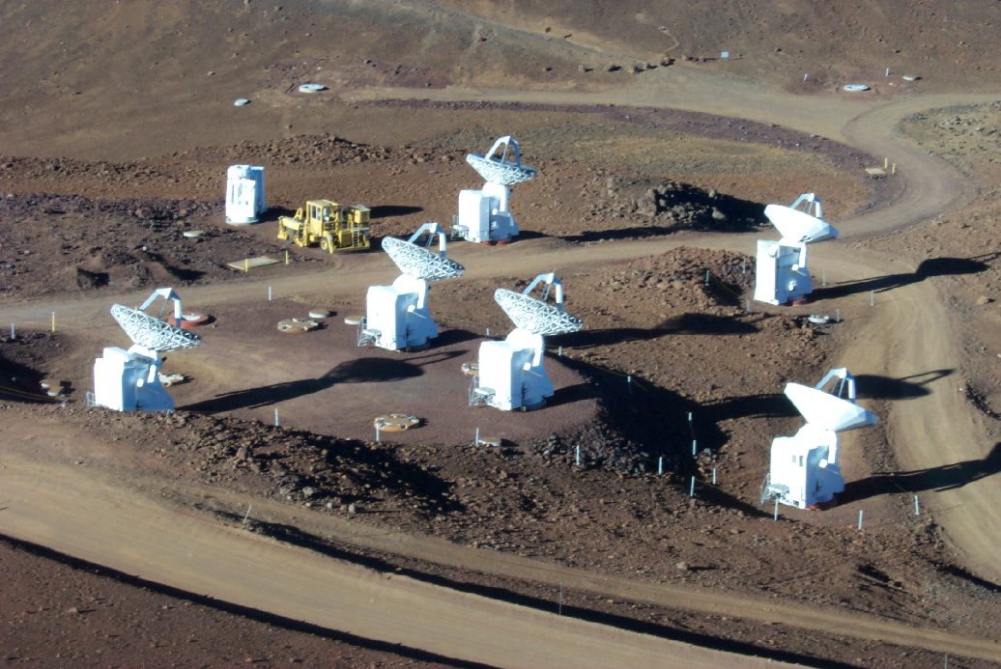
Sub millimeter Array on Mauna Kea

Slide 31
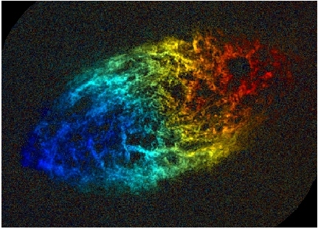
M33 doppler in Radio

